Slide 1

Student Management System

Slide 2

Guidance
By-
Mr.BalaKrishna Palla Reddy Sir

Slide 3

Team Members
Ashish Sitaram Deore
Drisya T
Iswarya V
K M Samiksha Yadav
Vanshika Shrivastava

Slide 4
INTRODUCTION
Student Management System is online portal.
SMS helps managing student records.
Objective is computerizing the process of student records management.

Slide 5
TECHNOLOGY USED
Front End Back End Database
1)Angular 1)Spring Boot 1)MySql
2)CSS
3)HTML

Slide 6
Modules
ADD NEW STUDENT RECORD
UPDATE EXISTING STUDENT RECORD
DELETE STUDENT RECORD
VIEW STUDENT RECORD

Slide 7
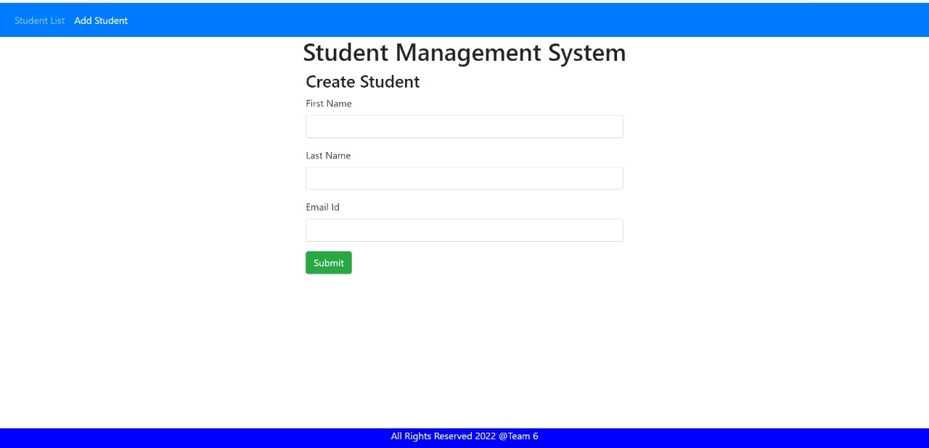
Demo

Slide 8
FRONTEND
ANGULAR :
Angular is a platform and framework for building single-page client applications using HTML,CSS and TypeScript.
CSS :
Cascading Style Sheets(CSS) is a stylesheet language used to describe the presentation of a document written in HTML.
HTML :
HTML is the standard markup language for creating Web pages. HTML describes the structure of a Web page.It consist of a series of elements.HTML elements tell the browser how to display the content.

Slide 9
Database
MySql :
MySql is an Oracle-backed open source relational database management system(RDBMS) based on structured Query Language(SQL).

Slide 10
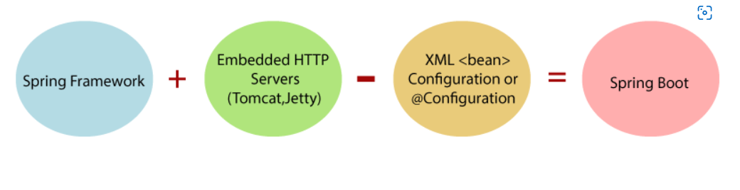
BACKEND
SPRING BOOT :
Spring Boot is a project that is built on the top of the Spring Framework.
It is a Spring module that provides the RAD (Rapid Application Development) feature to the Spring Framework.

Slide 11
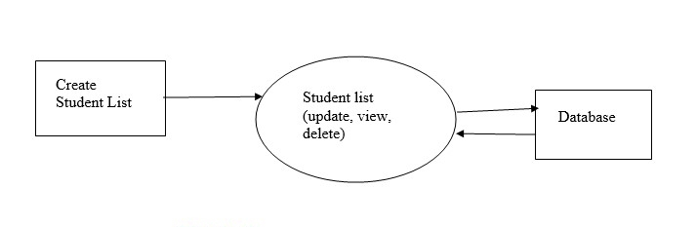
Application Flow Diagram

Slide 12
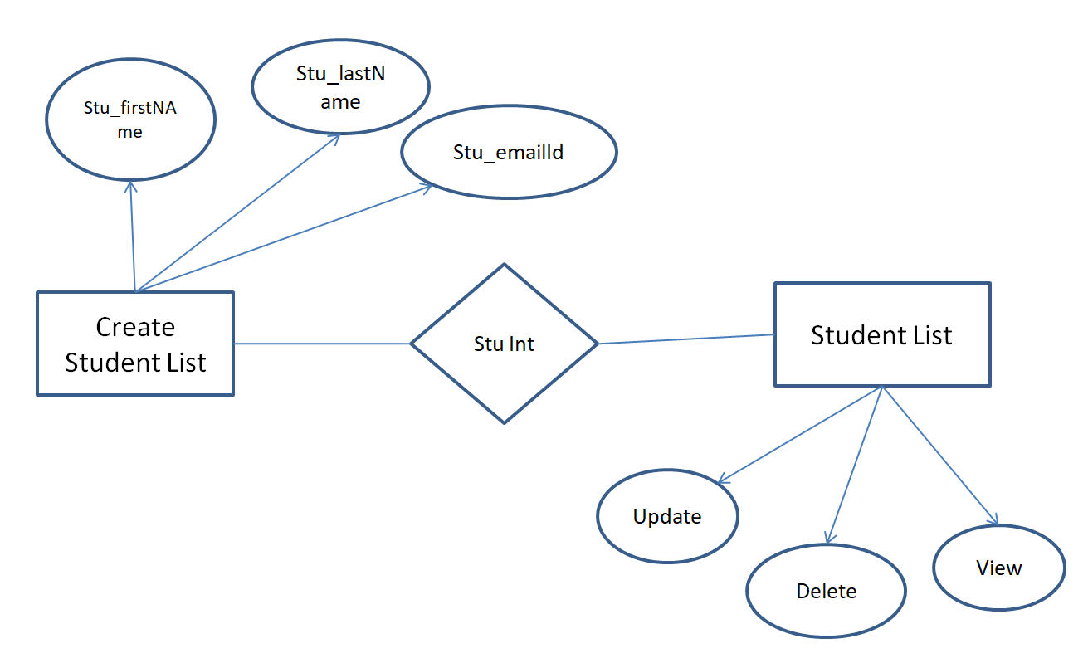
ER Diagram

Slide 13
FUTURE SCOPE
SMS can be enhanced to include some other functionality like inserting marks, attendance management.
Social networking can also be added wherein students can interact with each other.
Functionality of chat and messages can be added.

Slide 14
CONCLUSION
It was a wonderful and learning experience for us while working on this project.
The main purpose of this project is to reduce the manual work helpful to perform paperless work and manage all data.

Slide 15
Thank You

